Slide 1
Single Page Application

Slide 2
Multi page web applications vs. single page web applications
MPA is a traditional kind of web application.
Every time the application needs to display the data or submit data back to server it has to request a new page from the server and then render it in the web browser.
SPA is essentially an evolution of the MPA+AJAX design pattern
SPA requests the markup and data separately, and renders pages directly in browser

Slide 3
Single-Page Applications (SPAs) are Web apps that load a single HTML page
Dynamically update that page as the user interacts with the app.
SPAs use AJAX and HTML5 to create fluid and responsive Web apps, without constant page reloads.
However, this means much of the work happens on the client side, in JavaScript.

Slide 4
A single-page application (SPA) is a web application or web site that interacts with the user by dynamically rewriting the current page rather than loading entire new pages from a server.
This approach avoids interruption of the user experience between successive pages, making the application behave more like a desktop application.
In a SPA, either all necessary code – HTML, JavaScript, and CSS – is retrieved with a single page load,[or the appropriate resources are dynamically loaded and added to the page as necessary, usually in response to user actions.
The page does not reload at any point in the process, nor does control transfer to another page

Slide 5
Best example of a Single Page Application is Gmail.
Before loading Gmail you see a progress bar, as it fetches everything from server once and then all the rendering is done on the client side with calls to server only for fetching data and not the DOM.

Slide 6
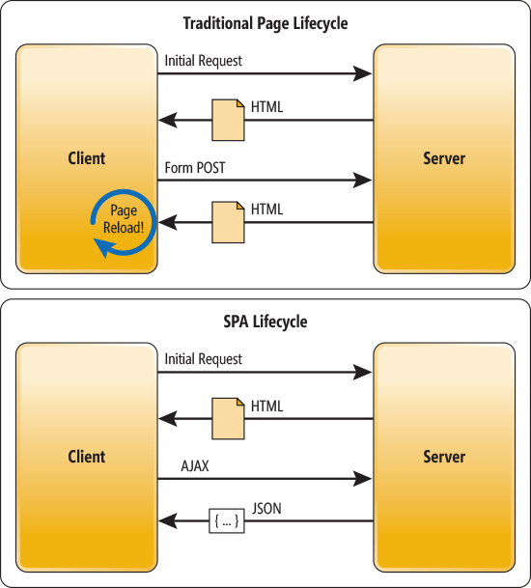

Slide 7
Apart from Gmail, other services in the suite like Google Calendar, Google Drive etc. are also Single Page Applications.

Slide 8
SPA framework?
Web browser JavaScript frameworks, such as AngularJS, Ember.js, Meteor.js, ExtJS and React have adopted SPA principles. AngularJS is a fully client-side framework. AngularJS's templating is based on bidirectional UI data binding.

Slide 9
Technical approaches
There are various techniques available that enable the browser to retain a single page even when the application requires server communication.

Slide 10
AngularJS
Ember.js
Meteor.js
Aurelia
Vue.js
React
Fulcro

